Slide 1



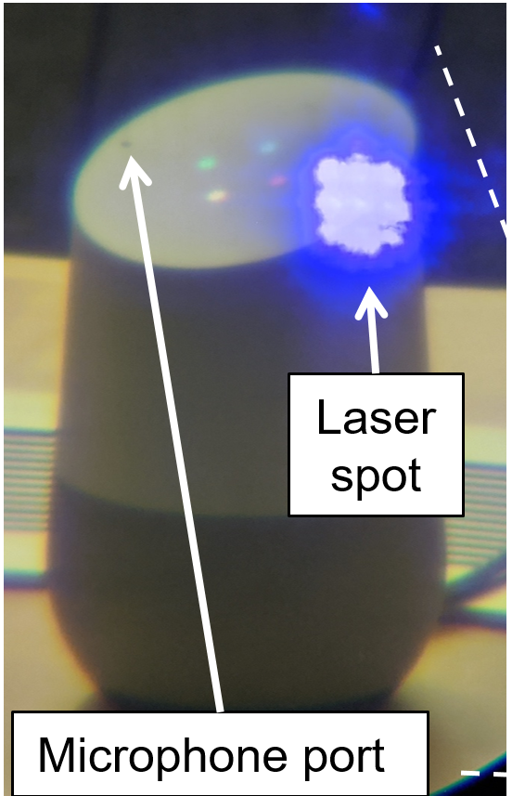
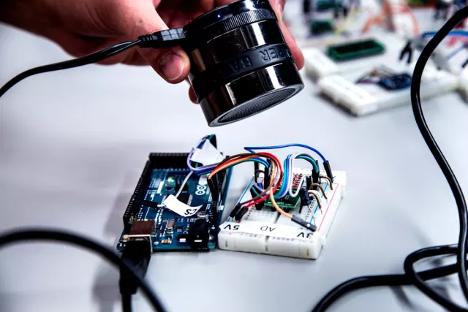
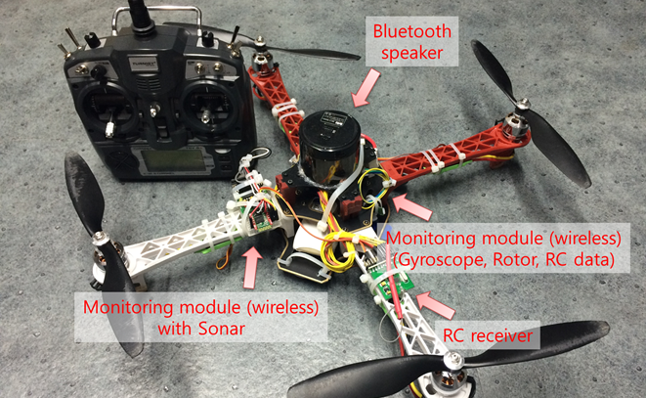






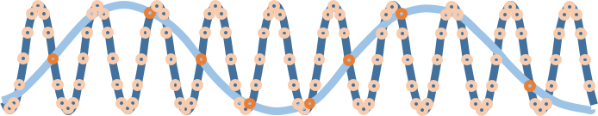
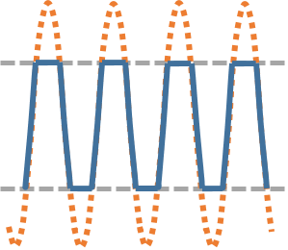






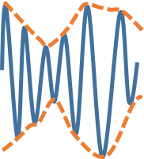
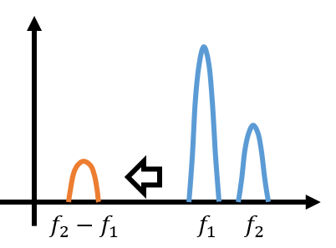





SoK:
A Minimalist Approach to Formalizing
Analog Sensor Security
We thank our shepherd Prof. Brendan Dolan-Gavit and the anonymous reviewers for their constructive feedback. This work was supported in part by the ZJU-OPPO-OnePlus Joint Innovation Center, NSF CNS-1330142, a gift from Analog Devices Inc., and by an award from Mcity at University of Michigan. The views and conclusions contained in this paper are those of the authors and should not be interpreted as necessarily representing the official policies, either expressed or implied, of the ZJU-OPPO-OnePlus Joint Innovation Center, NSF, Analog Devices, or Mcity.
Chen Yan, Hocheol Shin, Connor Bolton,
Wenyuan Xu, Yongdae Kim, Kevin Fu

Slide 2
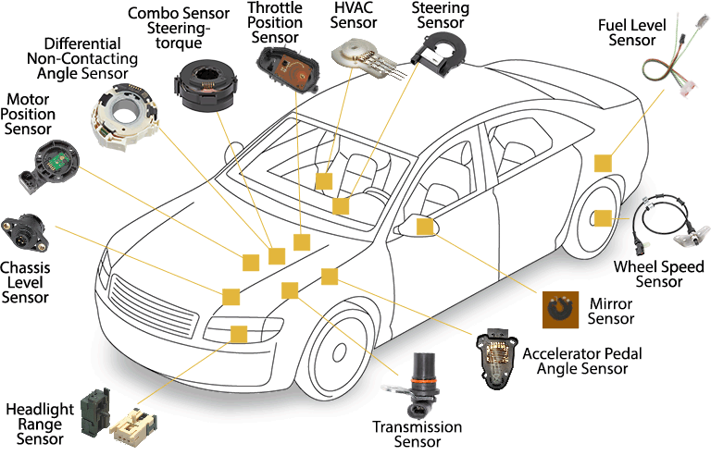
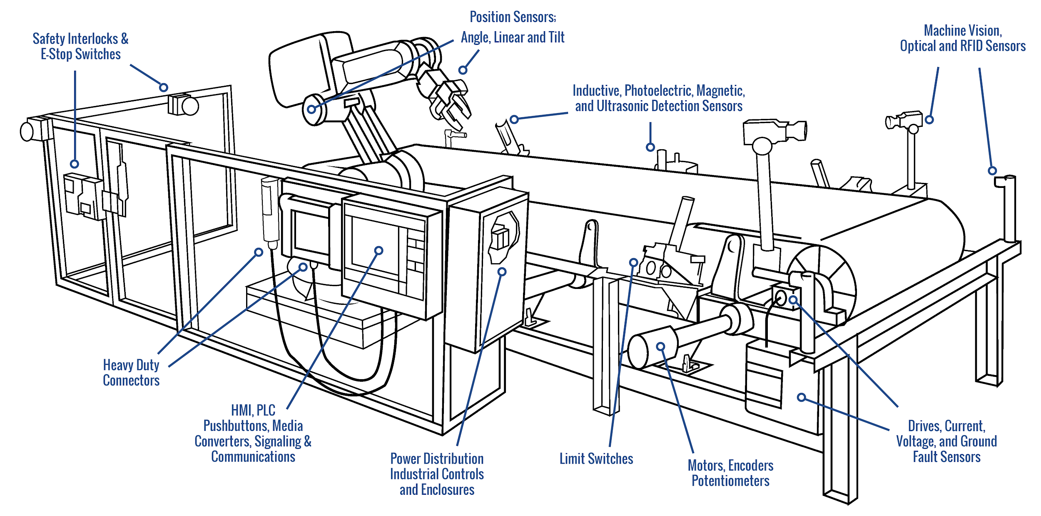
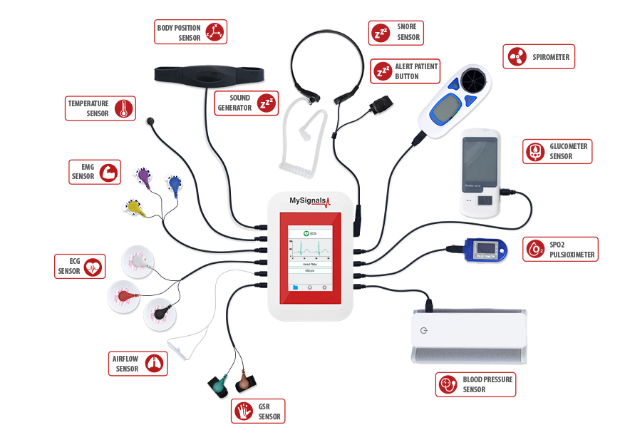
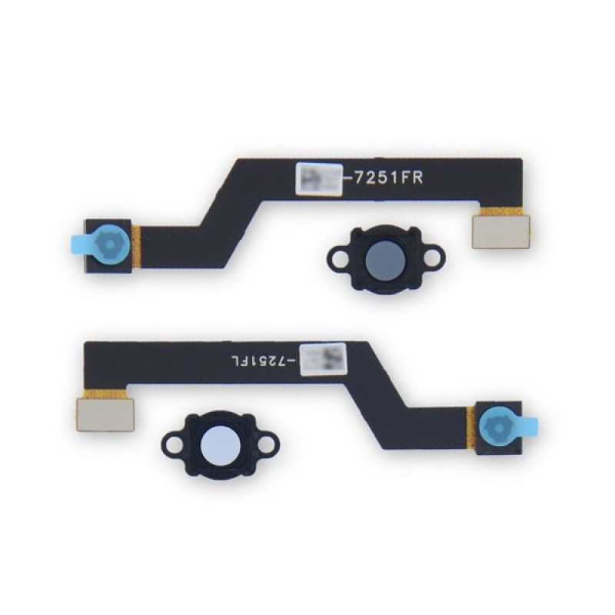
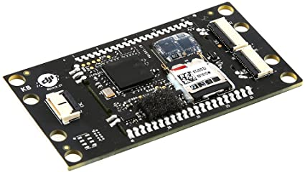
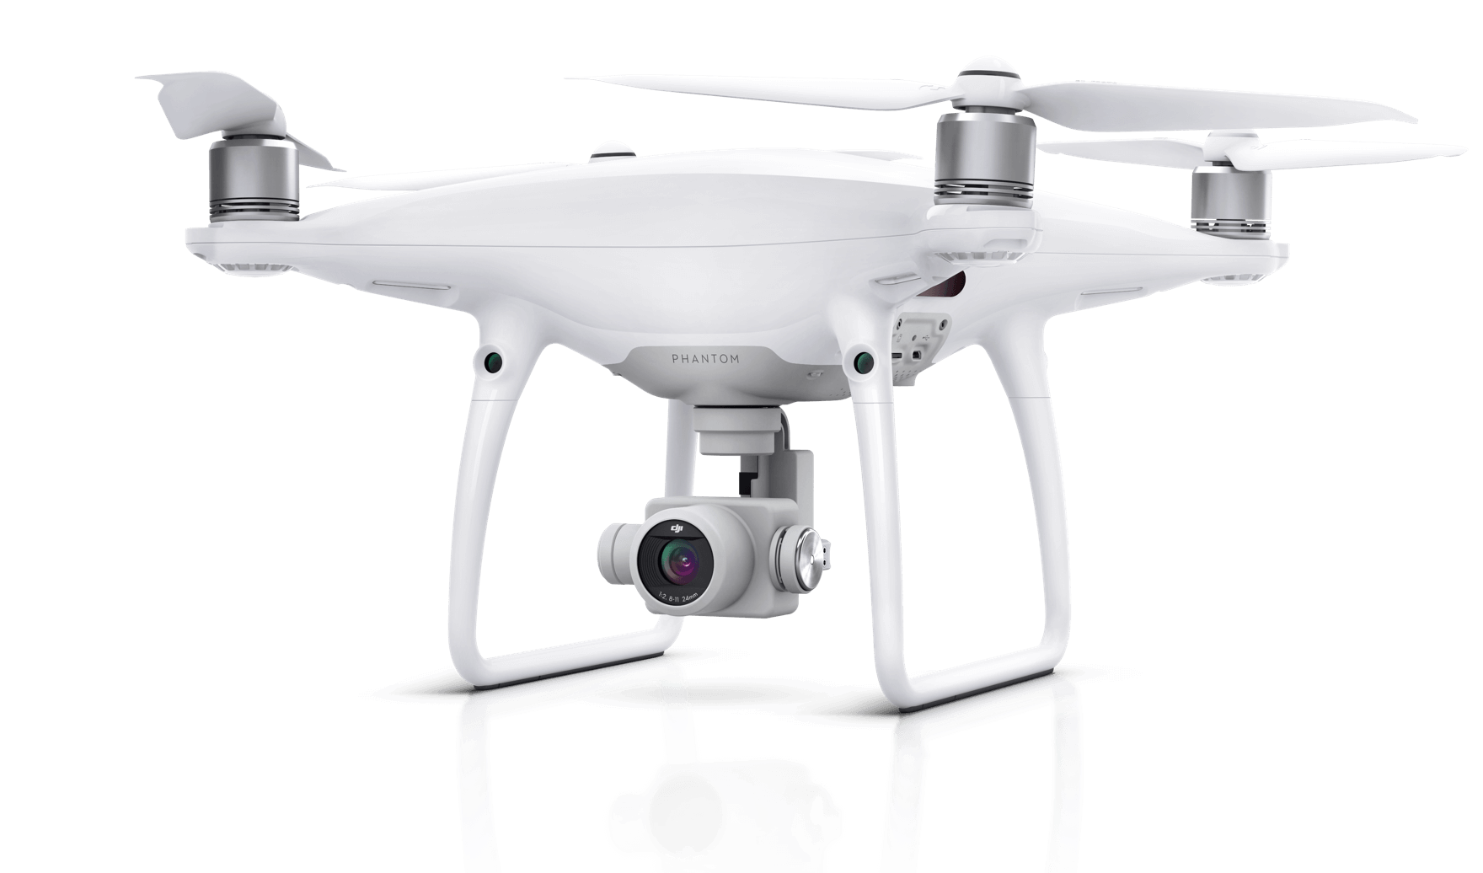

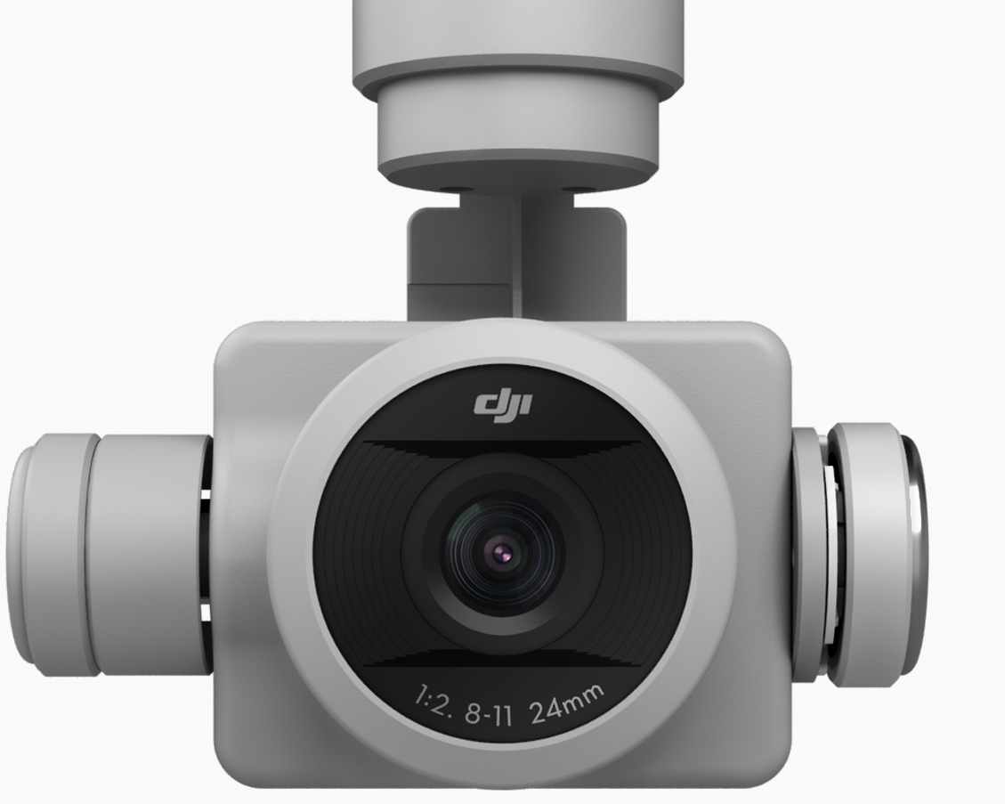
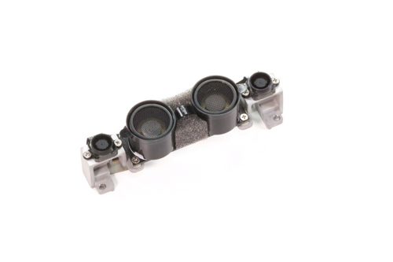
Sensors are everywhere!
Automotive
Manufacturing
IMU and Magnetometer
Infrared
Forward Vision Sensors
Drones
IoT
Camera
Ultrasonic and Bottom Vision Sensors

Slide 3







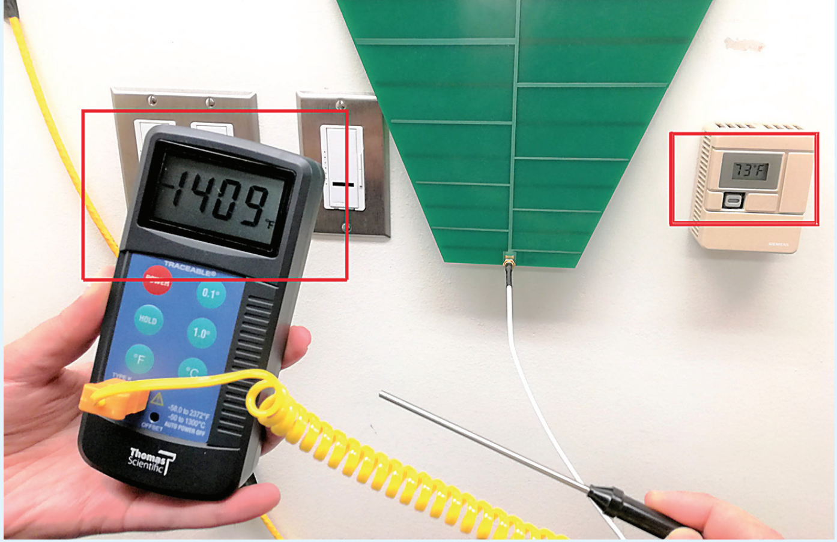
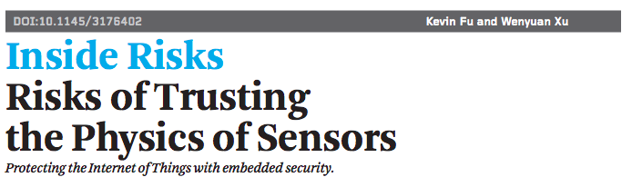
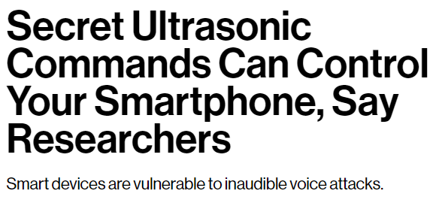
Transduction Attacks:
Attacks that use physical signals to induce untrustworthy sensor output
Cao, Yulong, et al. "Adversarial sensor attack on lidar-based perception in autonomous driving." ACM CCS, 2019.
Sugawara, Takeshi, et al. “Light Commands: Laser-Based Audio Injection Attacks on Voice-Controllable Systems.”
Son, Yunmok, et al. "Rocking drones with intentional sound noise on gyroscopic sensors." USENIX 2015.
Trippel, Timothy, et al. "WALNUT: Waging doubt on the integrity of MEMS accelerometers with acoustic injection attacks." IEEE EuroS&P, 2017
Zhang, Guoming, et al. "DolphinAttack: Inaudible voice commands." ACM CCS 2017.

Slide 4
Transduction Attacks: Challenges
Sensors are ubiquitous and heterogeneous
Varying attack signals, sensors, goals
Vocabulary and terminology differences
We found that there were conceptual similarities, but we lacked a simple way to express those similarities.

Slide 5
Contributions:
Simple Sensor Security Model
Tranduction attack systemization
Defense systemization
Prediction methodology for attacks and defenses.

Slide 6









What are commonly inside a sensor?
Stimulus
Sensor
Measurement
Input
ADC
Output
0101...
Analog to digital converter
Transducer
Amplifier
Filter
Physical signal
Analog signal
Digital signal
Speech
Audio file
ADC
Notes:
Sensors are energy transducers
Transducers convert one type of energy (or signal) to another
Linear superposition with the original inputs, e.g., noises.
Change the transfer functions, e.g., temperature.

Slide 7

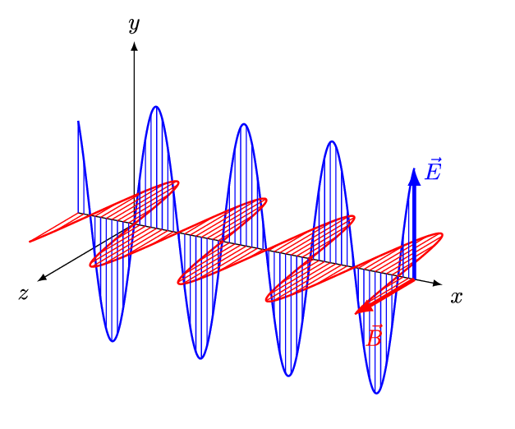

How do transduction attacks work?
Stimulus
Sensor
Measurement
Input
ADC
Output
0101...
Analog to digital converter
FALSE
Transducer
Amplifier
Filter
INJECT
Malicious
Physical
Signals
1. RF signals
2. Acoustic signals
3. Light
4. Magnet
5. Heat
Notes:
Sensors are energy transducers
Transducers convert one type of energy (or signal) to another
Linear superposition with the original inputs, e.g., noises.
Change the transfer functions, e.g., temperature.

Slide 8
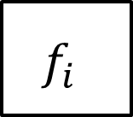
Simple Sensor Security Model
General Ideas
Common Properties
Sensor Model
Adversary in the Model
Similar analog signal processing
Same signal modalities
Sensitive to physical signals
Chain of blind trust
Model each sensor component with a transfer function
Model attacks by adding malicious signals into the model
Legitimate input
Input
Output
Output
Malicious input
Notes:
Sensors are energy transducers
Transducers convert one type of energy (or signal) to another
Linear superposition with the original inputs, e.g., noises.
Change the transfer functions, e.g., temperature.

Slide 9
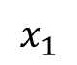
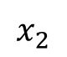
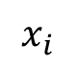
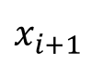
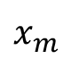
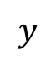


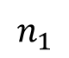
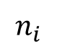
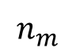
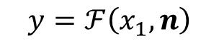
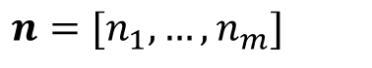
Simple Sensor Security Model
Transfer Function Representation
Stimulus
Sensor
Measurement
Input
ADC
Output
0101...
Analog to digital converter
Transducer
Amplifier
Filter
Stimulus
…
…
Measurement
Noise
Notes:
Sensors are energy transducers
Transducers convert one type of energy (or signal) to another
Linear superposition with the original inputs, e.g., noises.
Change the transfer functions, e.g., temperature.

Slide 10
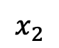
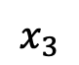
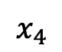
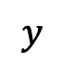
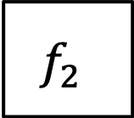
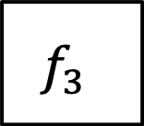
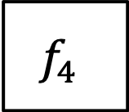
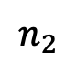
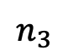
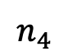
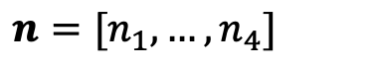
Simple Sensor Security Model
Transfer Function Representation: Microphone Example
Sound
Audio
Input
ADC
Output
0101...
Low-pass
Filter
Analog to digital converter
Microphone
Amplifier
Sound
Audio
Ambient
noise
Electrical noise
Notes:
Sensors are energy transducers
Transducers convert one type of energy (or signal) to another
Linear superposition with the original inputs, e.g., noises.
Change the transfer functions, e.g., temperature.

Slide 11
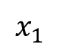
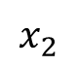
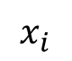
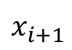
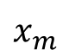
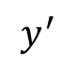



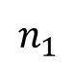
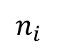












Simple Sensor Security Model
Adversaries in the Model
Stimulus
…
…
Measurement
Noise
Desired
Measurement
Stimulus
…
…
Noise
…
…
Desired value of y
Malicious Inputs
Sensor knowledge

Slide 12
Simple Sensor Security Model
Example: DolphinAttack (Zhang et al., CCS 2017)
Ultrasound
Malicious Audio
Input
ADC
Output
0101...
FALSE
INJECT
Microphone
Amplifier
LPF
ADC
Sound
Malicious
Audio
Noise
Desired value of y
Malicious Ultrasound
Sensor knowledge
Sound
Ambient noise

Slide 13


Attack Systemization
Common Attack Steps
ADC
0101...
Step 1: Signal Injection
Step 2: Measurement Shaping
Notes:
Based on our simple sensor security model, each transduction attack can be factored into two basic steps. The first step, “signal injection step”, decides by which means the attacker “injects” malicious signal to the signal chain of the victim sensor. This step can further be categorized into criteria like the kind, amplitude, or frequency of the physical signal used for the injection.
Although loading malicious signal onto the signal path of the victim sensor is always a starting point of every transduction attack, oftentimes this might not be enough to fulfil the final goal of the attacker. Here comes the second “measurement shaping step”, and these steps are composed of various transduction attack techniques to reconstruct the desired signal which the attacker ultimately wants to inject to the digital backend. This does not only mean making the raw injected signal survive after all the intermediate processing blocks. Interestingly oftentimes those intermediate blocks can be exploited to produce new malicious signals that were nonexistent in the initial raw signal.

Slide 14
Attack Systemization
Signal Injection Step (3 factors)
Pre-transducer
Post-transducer
Injection Point
ADC
0101
Signal Type
Pre-transducer: RF signal, light, sound, magnetic, electric...
Post-transducer: RF signal
Signal Frequency
In-band vs. out-of-band
Sensor | Expected Operating Band | Attack Frequency
MEMS Inertial Sensor | ≤ 750 Hz | > 1kHz
Microphone | ≤ 20 kHz | > 20 kHz

Slide 15







Attack Systemization
Measurement Shaping Step (5 types)
Saturation
Aliasing
Filtering
Intermodulation Distortion
Envelope Detection

Slide 16
Attack Systemization
Example: ① DolphinAttack & ② Ghost Talk
Injection:
Ultrasound
Pre-transducer
Out-of-band
IMD: Demodulate attack signal
①
Filtering: Remove attack signal
Malicious
Audio
Input
ADC
Output
Microphone
Amplifier
LPF
ADC
Injection:
RF signal
Post-transducer
Out-of-band
Filtering: Remove attack signal
②
IMD: Demodulate attack signal

Slide 17

Attack Systemization
Summary
Sensor
Categories
Exploited
Component
Signal
Inject
Steps
Measurement
Shaping
Steps
Paper
Outcome

Slide 18








Defense Systemization
Detection and Prevention
Input
ADC
Output
Malicious
Audio
Microphone
Amplifier
LPF
ADC
Ghost Talk
Injection:
RF signal
Post-transducer
Out-of-band
Filtering: Remove attack signal
IMD: Demodulate attack signal
Detection
Prevention
Notes:
For defenses, mitigating any step in the attack chain will alleviate the entire attack.
For example of Ghost Talk,
The entire attack would be relieved given a mitigation either to
injection[Click],
the IMD step[Click],
or the filtering step[Click].
Therefore, we defined defenses by the step they mitigate.
In addition to this basic principle, we divided defenses into two largest categories:
detection and prevention.

Slide 19
Defense Systematization:
Detection
Injection
TX Randomization
Verifying Actuation
Detecting Out-of-band
Measurement Shaping
Saturation Detection
IMD Feature Detection
Notes:
Detection defenses simply detects the presence of an attack.
We further divided these into two broad categories based on if they detected an injection or a measurement shaping step.
[Click] TX randomization randomizes the transmission pattern of the active sensors like radars
to resist attacks exploiting the predictability of the transmitted signal.
Injecting malicious signals without knowing the random pattern would violate the expected received signal and can be detected.
[Click]Verifying actuation validates the measurand by stimulating the object of measurement in a predefined manner
and comparing the response with the expected one.
If the sensor is being compromised this will reveal the existence of the attacker.
[Click]Last one, detecting out-of-band signals,
looks for any out-of-band signals in the signal path because they are apparently abnormal.
The rest deals with measurement shaping steps.
[Click]saturation detection monitors if the input level remains in the expected range and alerts otherwise.
[Click]IMD feature detection tries to seek unique symptoms of exploitation by IMD,
like numerous images in the frequency domain.

Slide 20
Defense Systematization:
Prevention
Randomization
Shielding
Filtering
Fusion
Component Quality Improvement
Notes:
The other category of defense, prevention,
allows proper operation even under an attack.
Like detection defenses, we divided these into five broad categories.
[Click] First, randomization can be utilized not only for detection but also prevention.
For example, to prevent attacks exploiting aliasing one might randomize sampling intervals.
This will deprive the control over aliased signal from the attacker.
[Click] Shielding simply block unnecessary outer signals.
It would be especially beneficial for sensors like inertial sensors, which have no need for exposure.
[Click] Filtering comprises of every defense enhancing or introducing filters.
Attacks originates from insecure stopband or passband arrangement can be prevented by this.
[Click] Sensor Fusion incorporates fusion of multiple sensor outputs,
multiple frequency bands,
or even multiple past measurements to enhance resilience.
[Click] Component quality improvement collectively denotes qualitative enhancement of internal components.

Slide 21

Defense systematization
Category and Subcategory
Related Component(s)
Injection and Shaping Steps
Paper
Goal
Xfer Function
Notes:
All these defenses can be systematized by our framework.
We sort each defense from previous studies by their goals,
corresponding categories,
sensor component,
injection and shaping steps they mitigate,
and transfer function models.
For more details, please refer to the paper.

Slide 22
Prediction: Attacks
Example: Part ① DolphinAttack
Injection:
Ultrasound
Pre-transducer
Out-of-band
IMD: Demodulate attack signal
①
Filtering: Remove attack signal
Malicious
Audio
Input
ADC
Output
Microphone
Amplifier
LPF
ADC

Slide 23

Prediction: Attacks
Example: Part ② Walnut
Malicious Acceleration
Input
ADC
Output
MEMS Mass
Amplifier
LPF
ADC
Injection:
Sound
Pre-transducer
Out-of-band
Filtering: Improper Filtering
②
Aliasing: ADC aliases signal

Slide 24
Prediction: Attacks
Example: Part ③ predicting an attack
AM Injection
Attacker Methods for AM Demodulation
Injection:
Ultrasound
Pre-transducer
Out-of-band
IMD: Demodulate attack signal
①
Filtering: Remove attack signal
Injection:
Ultrasound
Pre-transducer
Out-of-band
Filtering: Improper Filtering
②
Aliasing: ADC aliases signal
Injection:
Ultrasound
Pre-transducer
Out-of-band
Filtering: Improper Filtering
Predict
Aliasing: ADC aliases signal

Slide 25
Prediction: Defenses
Example: ① DolphinAttack & ② Ghost Talk
Established Defense: Filtering to remove IMD
Injection:
Ultrasound
Pre-transducer
Out-of-band
IMD: Demodulate attack signal
①
Filtering: Remove attack signal
Malicious
Audio
Input
ADC
Output
Microphone
Amplifier
LPF
ADC
Injection:
RF signal
Post-transducer
Out-of-band
Filtering: Remove attack signal
②
IMD: Demodulate attack signal
Predicted Defense: Filtering to remove IMD

Slide 26
Conclusion
Simple Sensor Security Model enables easier comparison of transduction attacks
Our systemization reveals how several attacks and defenses on different sensors can be conceptually similar
Analysis of past attacks via our model hints at future attacks and how to defend against them

Slide 27
SoK:
A Minimalist Approach to Formalizing
Analog Sensor Security
Join us afterwards for a discussion on sensor security!
Contact the authors at:
yanchen@zju.edu.cn
h.c.shin@kaist.ac.kr
mcbolto@umich.edu
Lab websites:
usslab.org
syssec.kr
spqr.eecs.umich.edu
Author websites:
connorbolton.com
sites.google.com/site/hocheolshincv
cyans.cn
We thank our shepherd Prof. Brendan Dolan-Gavit and the anonymous reviewers for their constructive feedback. This work was supported in part by the ZJU-OPPO-OnePlus Joint Innovation Center, NSF CNS-1330142, a gift from Analog Devices Inc., and by an award from Mcity at University of Michigan. The views and conclusions contained in this paper are those of the authors and should not be interpreted as necessarily representing the official policies, either expressed or implied, of the ZJU-OPPO-OnePlus Joint Innovation Center, NSF, Analog Devices, or Mcity.
Chen Yan, Hocheol Shin, Connor Bolton,
Wenyuan Xu, Yongdae Kim, Kevin Fu

